Slide 1

AC
info

Slide 2











$$Avg$$
$$RMS$$
A
$$≫DC$$
$$A$$
$$A$$
A
$$≫Asin\left(ωt\right)$$
$$\frac{2A}{π}$$
$$\frac{A}{\sqrt{2}}$$
A
$$≫Traingle$$
$$\frac{A}{2}$$
$$\frac{A}{\sqrt{3}}$$

Slide 3



What is Alternating current
Direct Current (DC)
$$+$$
Alternating Current (AC)
$$−$$
A DC current Do not change it’s direction
Direction of the current changes alternately with time.
DC Source
AC Source

Slide 4




Special case
RMS value : AC+AC of same $ω$
RMS value :AC+DC or AC+AC of different $ω$
$$y=Asin\left(ωt\right)+Bsin\left(ωt+{60}^{o}\right)$$
$$y=A+Bsin\left(ωt\right)$$
$$y=Asin\left(ωt\right)+Bsin\left(2ωt+{60}^{o}\right)$$

Slide 5
Skin Effect
The tendency of an alternating electric current (AC) to flow from surface only is called Skin effect.
Most of the Current flow from Surface only
For in case of AC we use hollow conductor
In order to Keep total area same we use bundle form of wire

Slide 6


Understanding
Skin Effect
$$⨂$$
Increasing
North pole
Assuming this current is increasing
Zone closer to the centre
Zone away from the centre
Induced current is opposing main current nature of increasing.
Induced current is supporting main current nature of increasing.

Slide 7




Direct Current (DC)
Alternating Current (AC)
$$+$$
Supply
$$−$$
DC Source
AC Source
Signal
Moving Coil Galvanometer
Or
Tangent Galvanometer
These will work normally
These will not work
MCG
TG
For lower frequency like 1,2 Hz it will oscillate.
For higher frequency like 50 Hz it will not move.
$$I∝θ$$
$$I∝tanθ$$

Slide 8

Direct Current (DC)
Alternating Current (AC)
Hot wire galvanometer
This is based on heating effect
$$\left[H=I^{2}Rt\right]$$
It will show RMS value
It will work for both supply
Scale will be non uniform
Wire type
Any type of wire will work
Hollow and Bundel conductor are used
Which is more dangerous
In general DC is more dangerous as in AC current will take zero value Hundred times in a second
But in NCERT it is written for same value AC is more dangerous as Peak value of AC is more than written[RMS] value

Slide 9


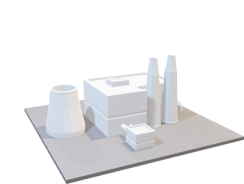

Create 320V,10A
Want 220V and 10A
Loss of 100V
Want 220V and 10A
$$R = 10Ω$$
Get 120V only
$$R = 20Ω$$

Slide 10
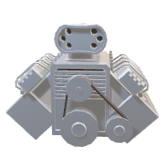




Transformer Introduction
V=22000V
I=0.1A
Want 220V and 10A
Create 220V,10A
R = 10$Ω$
$$X100$$
$$X\frac{1}{100}$$
Step up transformer
Step down transformer

Slide 11
Primary
Secondary
Transformer ratio

Slide 12














If we assume no loss of energy
$$I_{2}e_{2}$$
$$⇒I_{1}e_{1}=$$
$$⇒\frac{I_{1}}{I_{2}}=\frac{e_{2}}{e_{1}}$$
$$=\frac{N_{2}}{N_{1}}$$
NOTE:
$$\frac{e_{1}}{e_{2}}=\frac{N_{1}}{N_{2}}$$
Valid even if efficiency is not 100%
Flux for each loop is same
$$\frac{I_{1}}{I_{2}}=\frac{N_{2}}{N_{1}}$$
Valid only if efficiency is 100%
Total $φ∝$
$N$
$\frac{φ_{1}}{φ_{2}}=\frac{N_{1}}{N_{2}}$
$$e=\frac{dφ}{dt}$$
$$\&$$
If efficiency is given
$$η=\frac{V_{out}∗I_{out}}{V_{in}∗I_{in}}$$
$$\frac{e_{1}}{e_{2}}=$$
$$\frac{N_{1}}{N_{2}}$$

Slide 13

Question
Question
Question
If frequency of input is f what will be output frequency.
Will transformer work with DC supply
Why transformer have high efficiency
?
?
?
Solution
Solution
Solution
Output Frequency will be $f$
NO
As they do not have any moving part

Slide 14


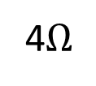


Question
Question
What will be the voltage of output side if input voltage is 220V
Find current in the bulb
100 turns
20 turns
100 turns
20 turns
200V
4$Ω$
Solution
This will not work as supply is DC
Solution
$$⇒\frac{e_{1}}{e_{2}}=\frac{N_{1}}{N_{2}}$$
$$⇒\frac{220}{e_{2}}=\frac{100}{20}$$
$$⇒e_{2}=44Volt$$

Slide 15
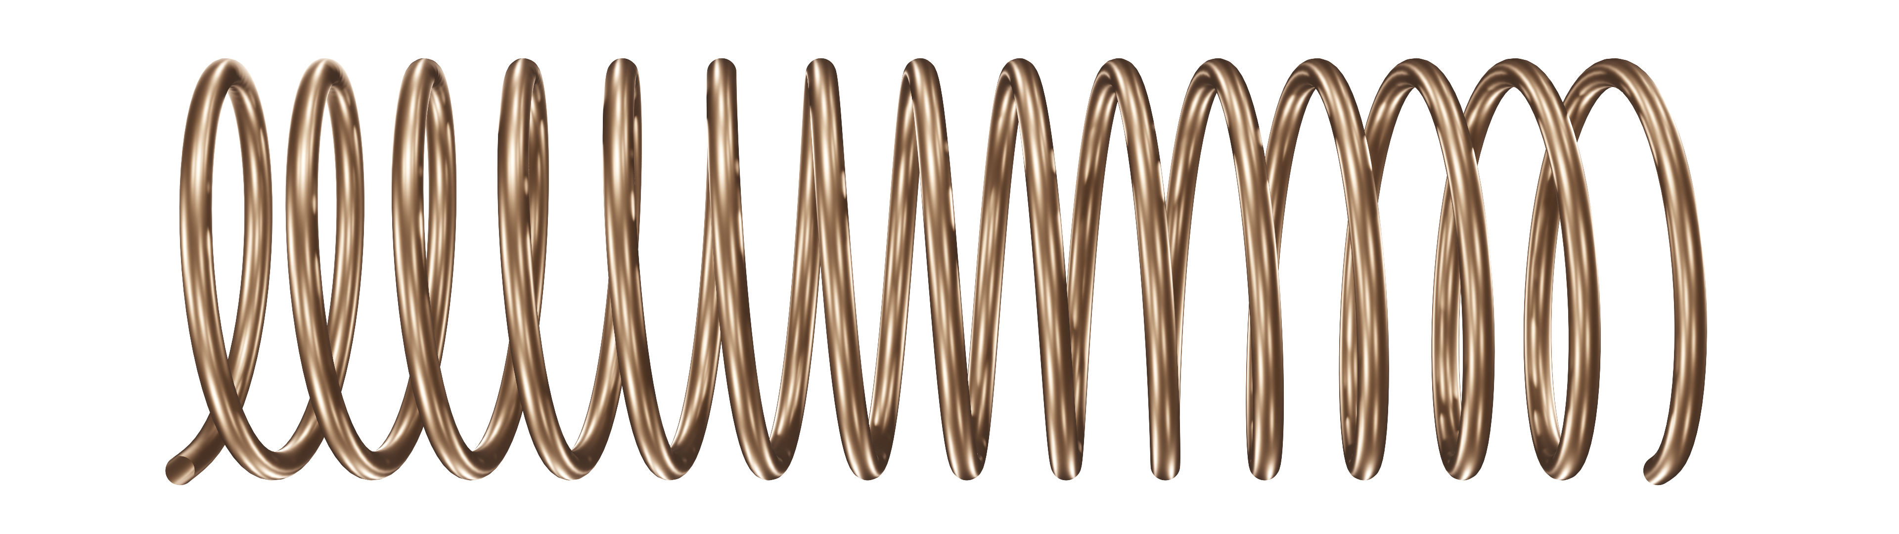
Transformer Losses
Flux Leakage
Copper loss
Iron lass
Issue:
Fix:
Issue :
Fix :
Issue :
Fix :
Use material of less resistance
Heating effect in wire
OR use Diamagnetic material around it

Slide 16
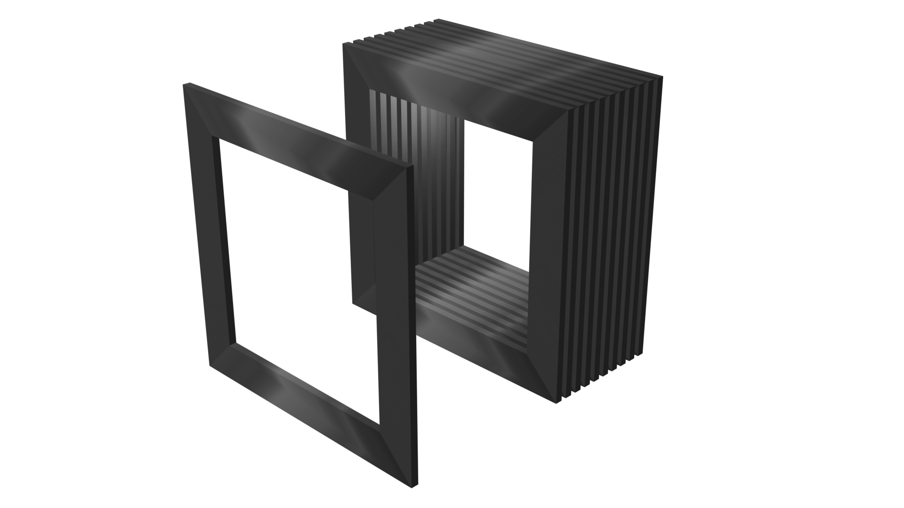





Transformer Losses
Iron lass
Issue :
Fix :
Flux Leakage
Copper loss
Eddy current loss
Use Laminated core
Issue:
Fix:
Issue :
Fix :
Use material of less resistance
Hysteresis loss
$$I$$
Use soft iron
$$I$$
It produce humming noise
Heating effect in wire
$$H$$
OR use Diamagnetic material around it
$$H$$

